Slide 1


Industrialization
of a Data Science use-case using Open Source technologies
CRP
Jyotishka DAS, Shamir MOHAMED, Xinran YAO, Jiayi WU, Priyam DASGUPTA

Slide 2
Table of Contents
01 Introduction & Objective
02 Model
03 MLOps: Pipelines Orchestrations
04 MLOps: Model serving through API
05 Value Creation
06 Business Recommendations

Slide 3
01
Project
Context

Slide 4
Project Context
Develop
Leverage
Enable
Develop and establish a comprehensive machine learning (ML) pipeline for industrializing a specific use case, focusing on predicting employee churn rate.
Leverage open source technologies such as MLflow and Airflow to orchestrate the ML pipeline, enabling efficient management and deployment of ML workflows.
Enable the HR department to proactively address employee attrition and optimize workforce management strategies by leveraging advanced ML techniques and generating valuable insights and forecasts.

Slide 5
02
Model

Slide 6
Dataset & Data Preprocessing
Dataset
The IBM HR Analytics Employee Attrition Performance dataset contains information on 1,470 employees and 35 factors representing various aspects related to employees in the dataset, such as their age, job details, work environment, personal information etc. There were no missing values.
The mean age is ~37 years and mean monthly income is ~6500 USD.
Preprocessing
Label Encoding : Label Encoding and One Hot encoding is necessary to encode categorical labels with numerical values.
Feature scaling : It is an essential step in preprocessing which involves transforming the numerical features in the dataset to a common scale or range so that all features contribute equally to the model training process. MinMaxScaler was implemented.
…

Slide 7
Model Performance
Algorithm | Accuracy
Random Forest | 85.12
K - Nearest Neighbour | 84.67
Support Vector Machines | 84.30
Decision Tree Classifier | 80.31
Logistic Regression | 76.51
In this study, we employed 10-fold cross-validation to evaluate the performance of the various models to mitigate the risk of overfitting or underfitting and provide a more robust estimate across different subsets of the data.
It was observed that the Random Forest Classifier provided the highest accuracy of 85.12 %.
Since it aggregates predictions from multiple decision trees, the impact of individual noisy or outlier instances is reduced.
The ensemble nature of Random Forest helps to smooth out the effects of individual data points, resulting in more accurate predictions.
Note: For more details on literature survey and pre-processing steps, please refer to the report

Slide 8
Top 5 Influential Factors
Overtime
Employee Attrition
Daily Rate
Total working years
Age
Monthly
income

Slide 9
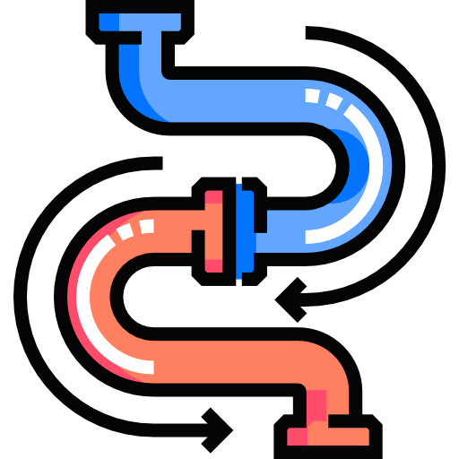
03
Pipeline Orchestration

Slide 10
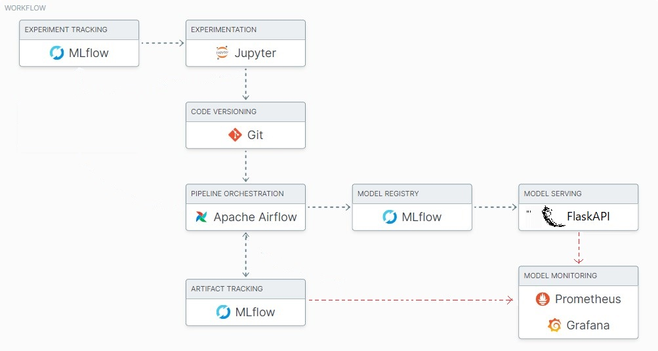
Various MLOps tools as used for building the scalable pipelines in the project

Slide 11
Pipeline Orchestration Using Airflow
1
2
3
4
Initialize a DAG
DAG (Directed Acyclic Graph) is the workflow or pipeline structure in Airflow.
DAG defines tasks and their dependencies for scheduling and execution.
Create Tasks
Tasks are interconnected steps in the pipeline defined by PythonOperator and DummyOperator.
PythonOperator executes Python functions, while DummyOperator is a placeholder.
Task functions: read data, prep encoding, prep scale, ml flow function, end task.
Define Task Dependencies
Task dependencies coordinate and synchronize tasks in the pipeline.
The task dependencies were defined as following: read data task >> prep encoding task
>> prep scale task >> ml flow function task >> end task.
Task Scheduling
Set start date and schedule interval attributes of the DAG.
start date: May 9, 2023.
schedule interval: "@hourly" (executes every hour).
catchup: False (DAG does not catch up on missed runs)

Slide 12
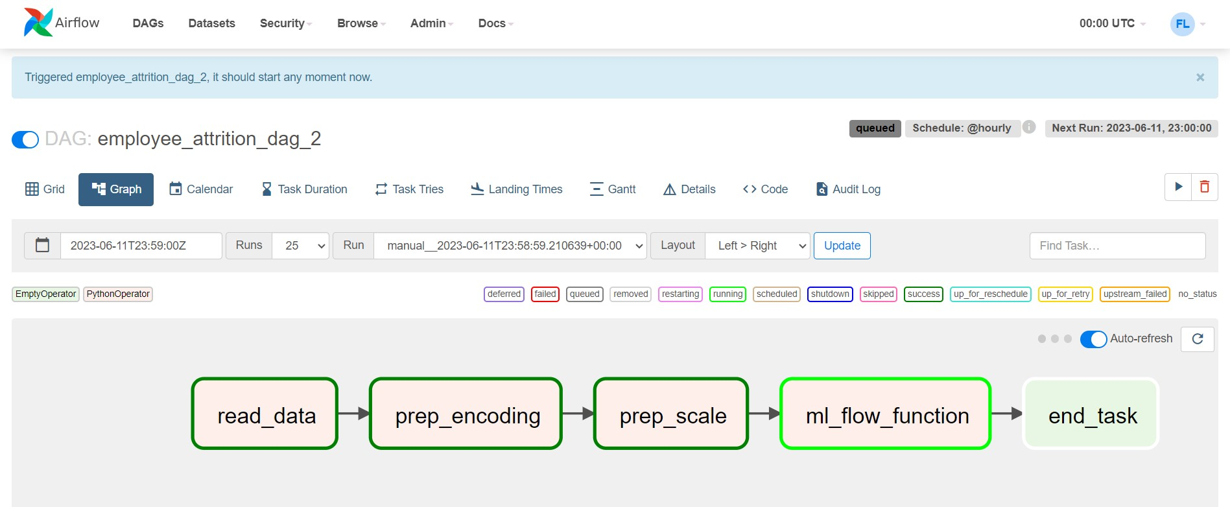
A DAG constructed in AirFlow shows the status of the sequential task

Slide 13
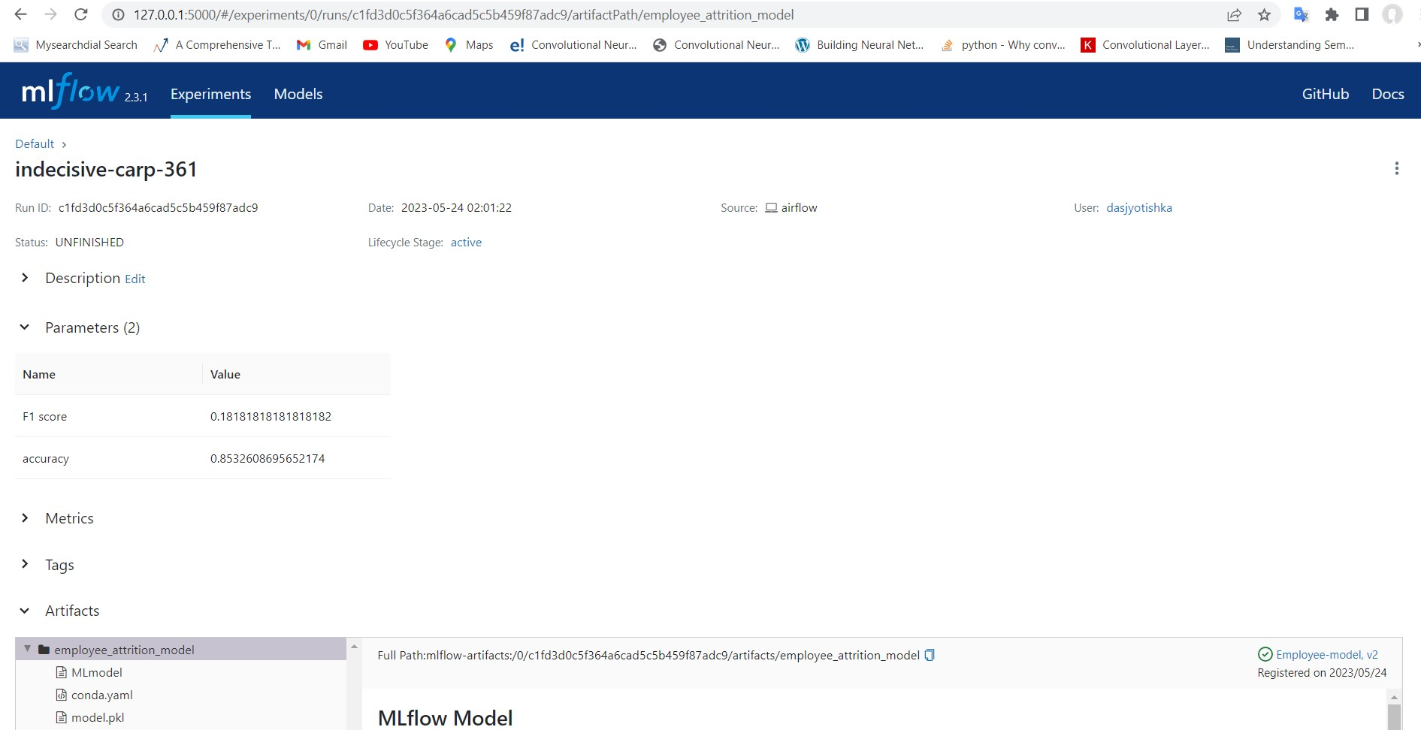
MLFlow registry showing the run-id and metrics of the saved model

Slide 14
Value Proposition of Pipeline Orchestration
Improved Efficiency
enable automation and orchestration of tasks
lead to increased efficiency in data processing and analysis.
Reproducibility
ensure consistent and reproducible results
reduce errors and improve data quality
provide reliable and trustworthy outputs
Cost and Time Savings
eliminate repetitive and time-consuming tasks
reduce manual effort, save time and operational costs
Scalability
Manage complex workflows
scalable and adaptable to changing business needs.

Slide 15
04
Model Serving through API

Slide 16
Value proposition by Model Serving through API
Real-time predictions
Integrations with other systems
Continuous Improvement
Accessibility
Security and Control
Non-tech teams such as HR can leverage the model's predictions without needing technical understandings
Reduce churn by responding to changes in employee behavior on the go and take prompt engagement
Predictions can be integrated into existing software system (eg, HRIS) for comprehensive analysis
As new data becomes available, the ML model can be retrained and updated, while the API remains unchanged.
Protection for sensitive employee information. No data leakage through authentication through API
These benefits contribute to efficient decision-making and the ability to proactively address employee attrition, leading to improved workforce management and organizational performance.

Slide 17
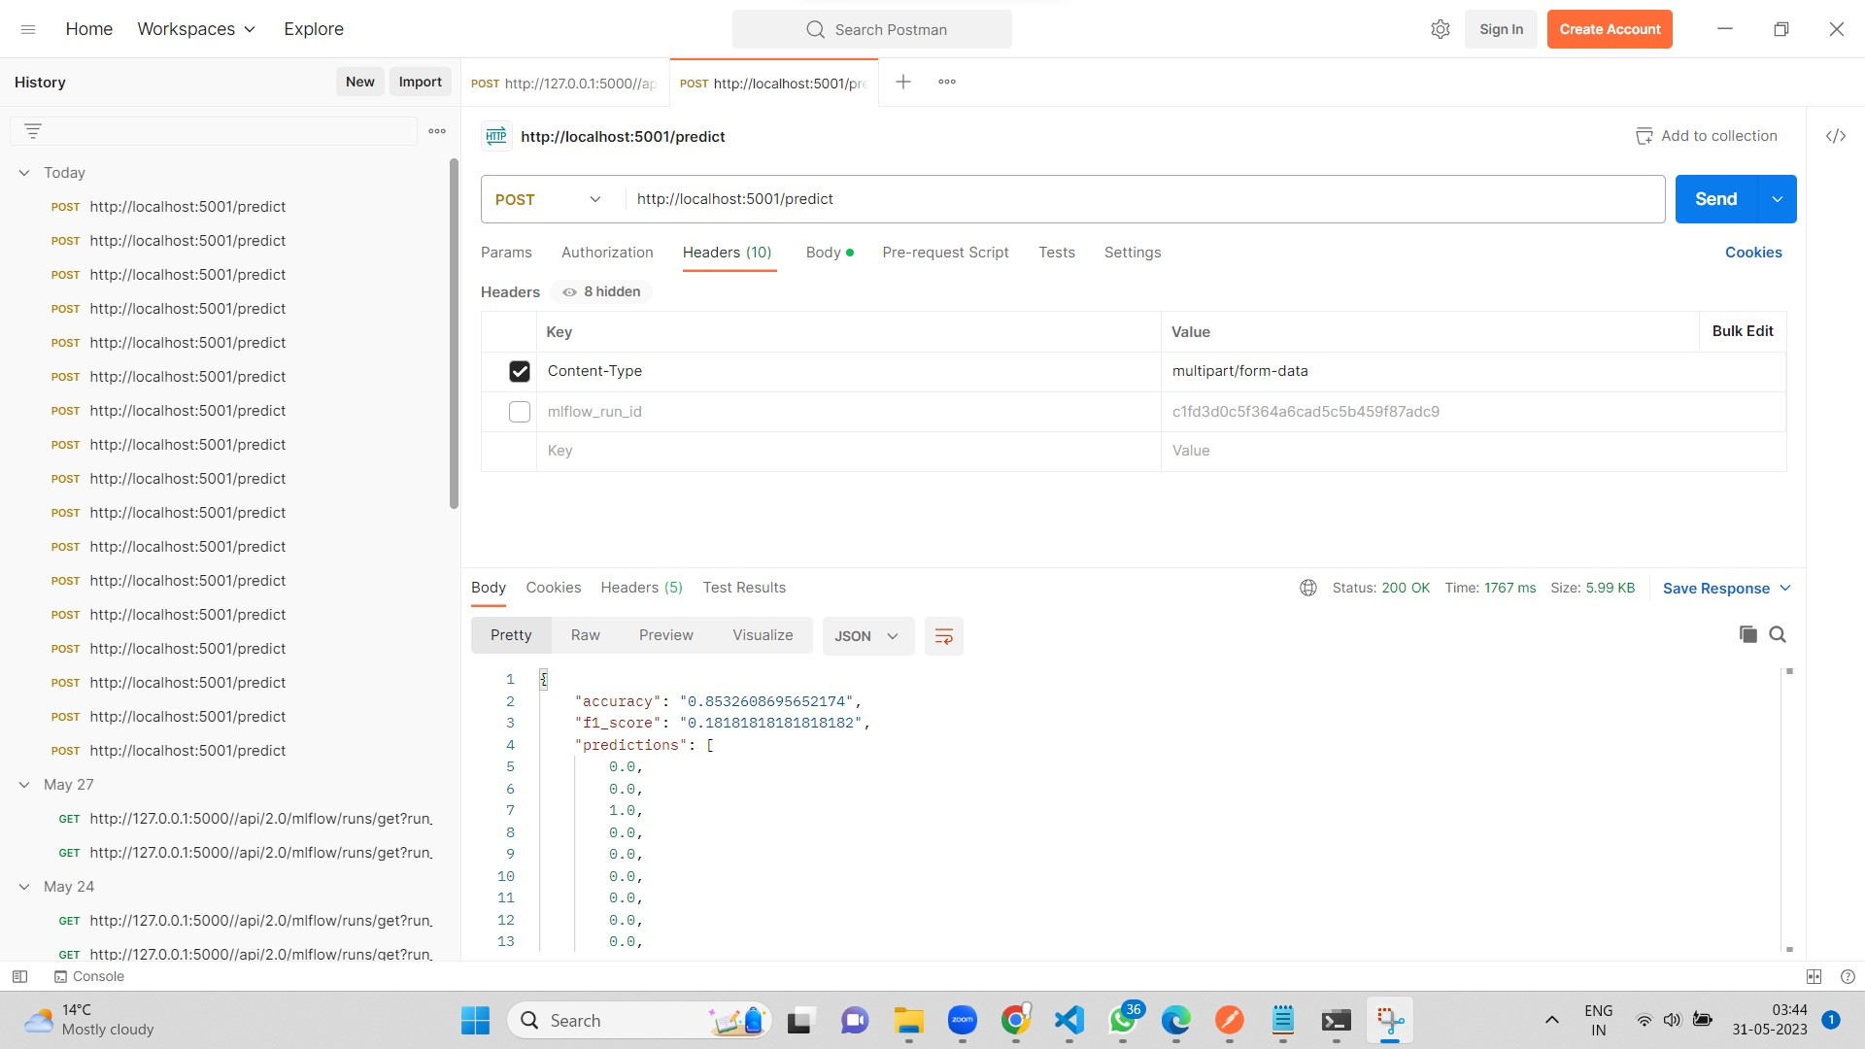
Test results as obtained from the response from the Flask app when a request is send through API via Postman web client

Slide 18
05
Business Recommendations

Slide 19
Strategize on the Two-pronged values created
Business Aspect
Reversing Human Capital drain
Decreasing unnecessary expenses in future hiring processes
Engineering Aspect
An efficient and scalable solution
Easy to manage, and reusable
Cutting future R&D costs
Increasing efficiency

Slide 20
Recommendations on Influential Factors
Total working years
Creating long-term career development plans and providing growth opportunities for employees, mentorship programs, training initiatives, and promotions based on performance can encourage employees to stay committed to the organization.
Overtime
Implementing policies that limit excessive overtime and providing adequate support to employees can help reduce burnout and increase job satisfaction.
Monthly income
The level of monthly income has a direct impact on attrition. It is crucial for companies to ensure that their compensation packages are competitive and aligned with industry standards.
Daily Rate
Regular benchmarking exercises, salary adjustments, and rewards for high-performing employees can help in reducing attrition related to inadequate pay.
Age
Older workers generally exhibit higher levels of retention due to their tendency to remain with the same organization for longer periods. Factors such as job stability, experience, and a sense of loyalty often contribute to their reduced attrition rates.

Slide 21
Thank you

